Slide 1


Paris ‘Dans Ma Rue’ App & INSEE Socio-economic Indicators
Natanael PITOUN
JUN, 10th | PARIS
DATA Analytics 2022

Slide 2

Use Case
Domain
Community Communications & Social Analysis
Using citizen generated data with socio economic statistics
to improve public policy
Setting the groundwork for future analysis of community issues in Paris

Slide 3
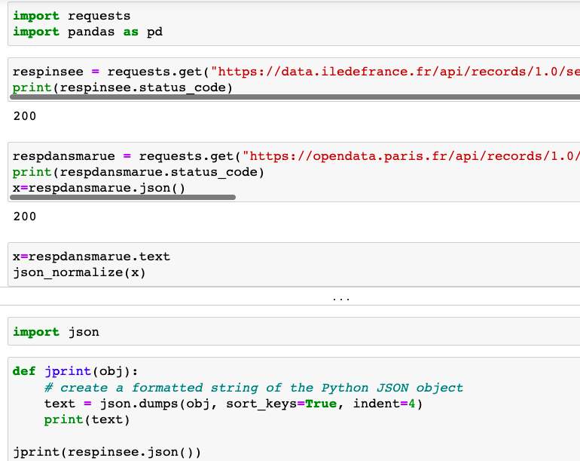
The Plan
Collect the data Via an API or direct download
Format the Json & Csv files
Use Pandas to analyze the data
Create a Database & Tables
Further analyze the data with queries

Slide 4
The data
The Plan
Collect the data Via an API or direct download
Format the Json & Csv files
Use Pandas to analyze the data
Create a Database & Tables
Further analyze the data with queries
Both Publicly Available under the OpenDatabase Licence
Insee Statistics about the Ile-de-France Region
Exhaustive Socio-Eco Stats for each municipality
‘Dans Ma Rue’ App Data
Close to a million single reports by citizens about different problems encountered in the streets of Paris

Slide 5
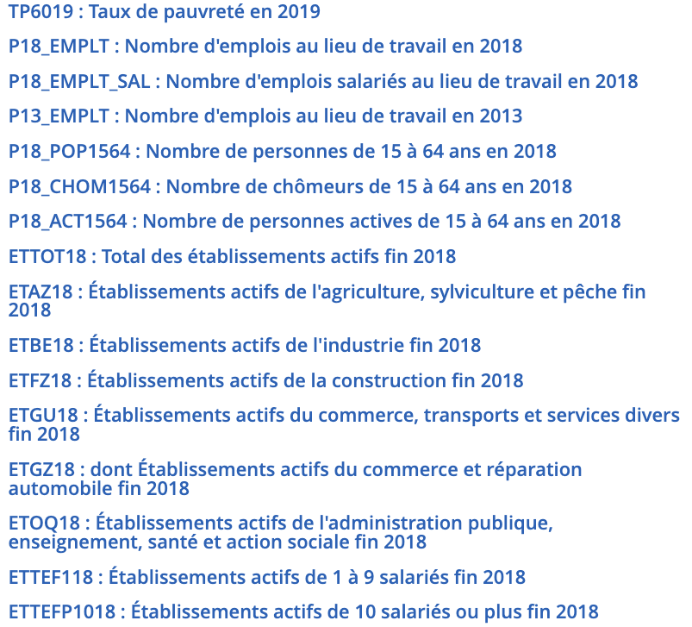
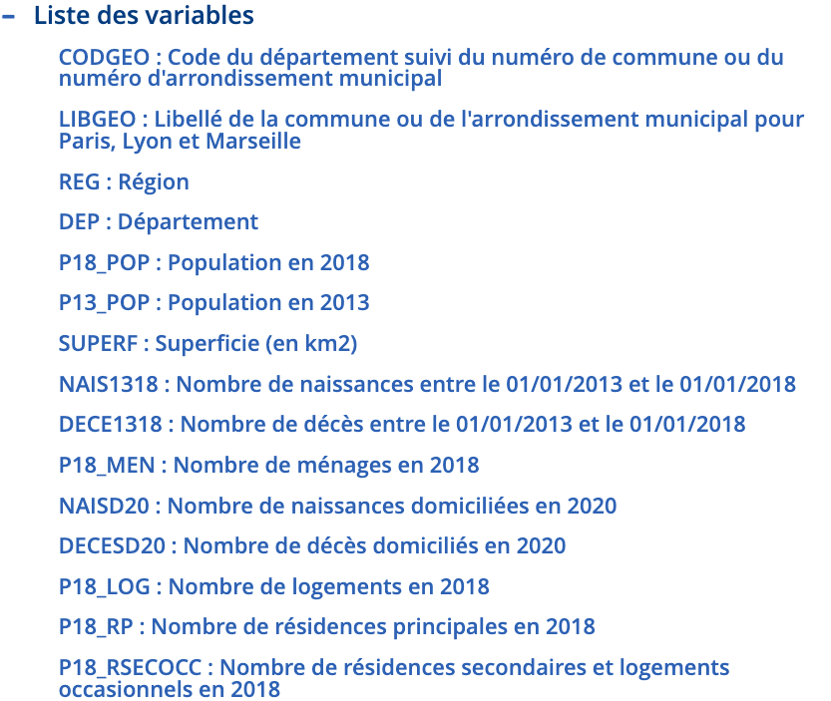

Slide 6
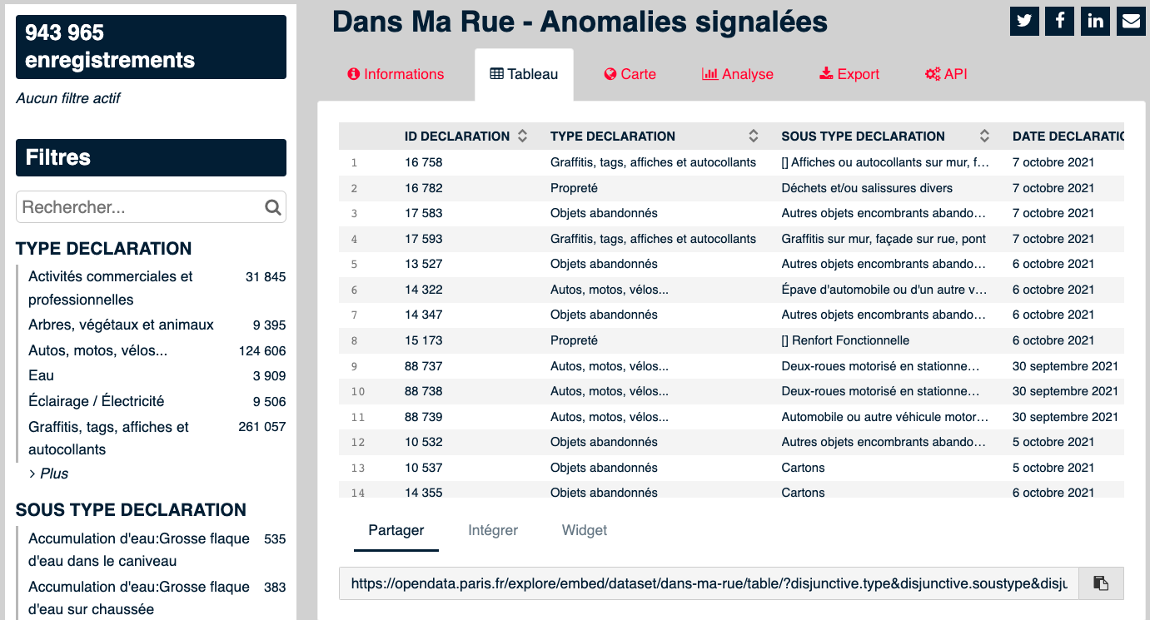
https://opendata.paris.fr/

Slide 7
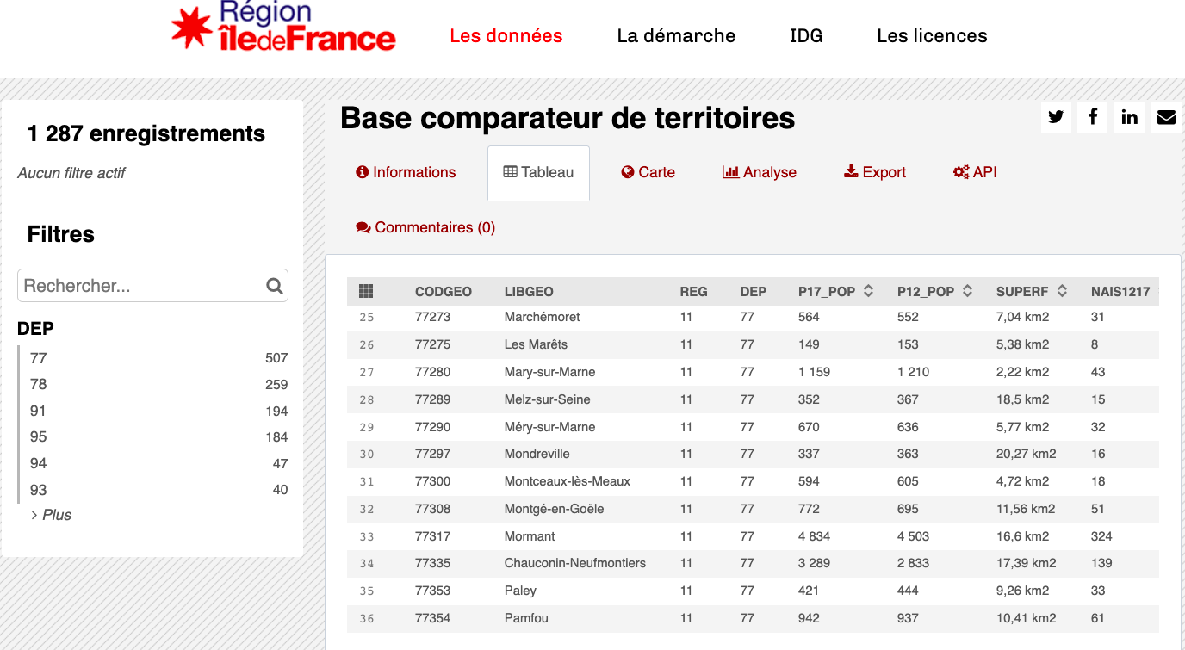
data.iledefrance.fr/

Slide 8
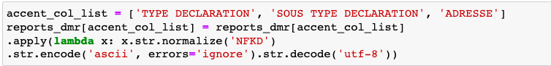
Data cleaning & data prep
Using ‘str.replace’ and in some instances, with Regex
Removing accents using a lambda function & string encoding
Remove repetitive column variations using ‘drop
The data did not contain missing values

Slide 9
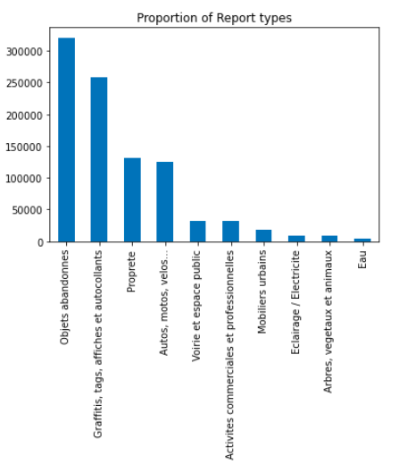
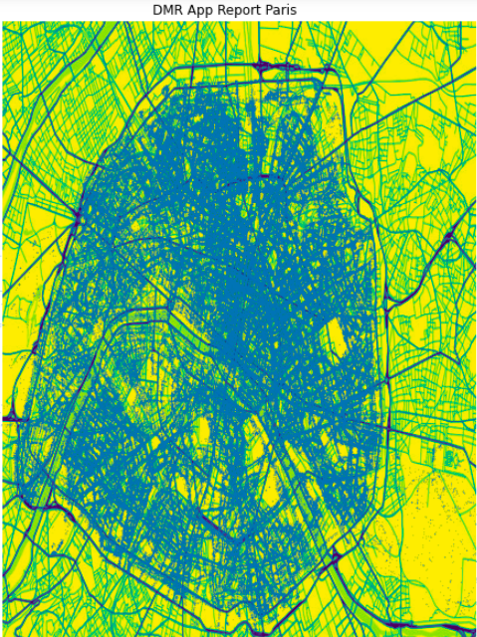
EDA

Slide 10
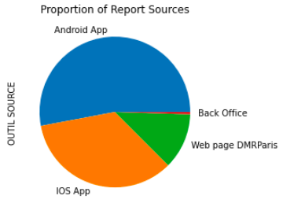
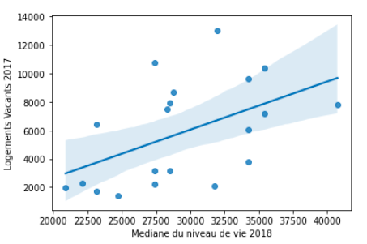
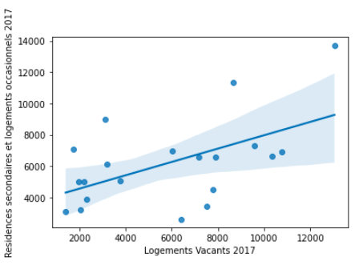

Slide 11
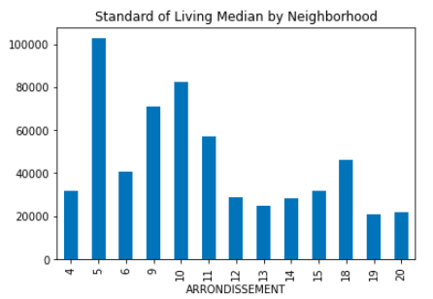
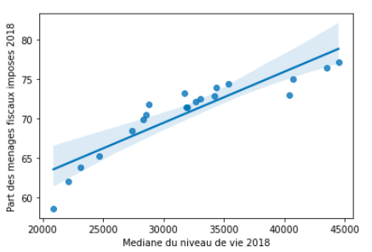
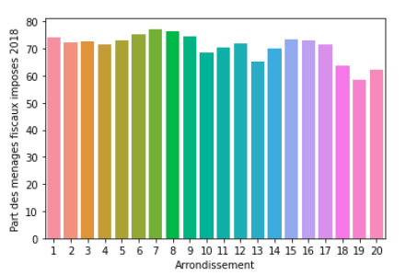
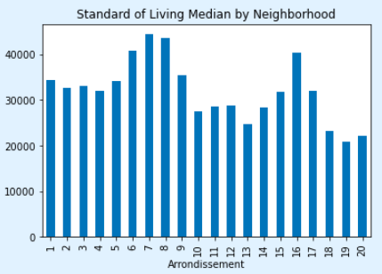

Slide 12
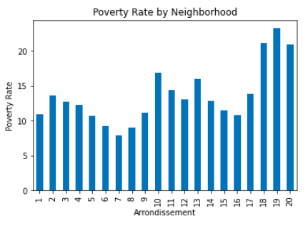
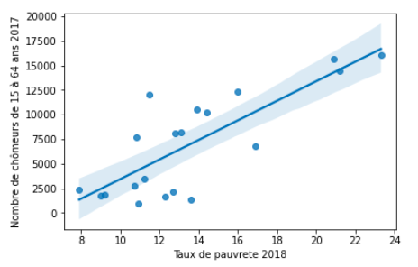

Slide 13
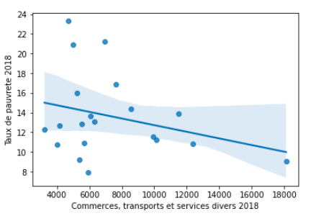
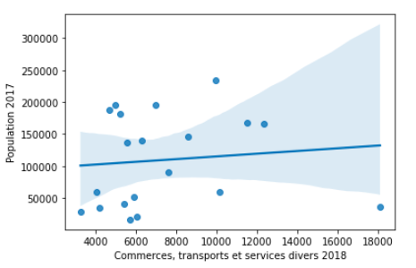
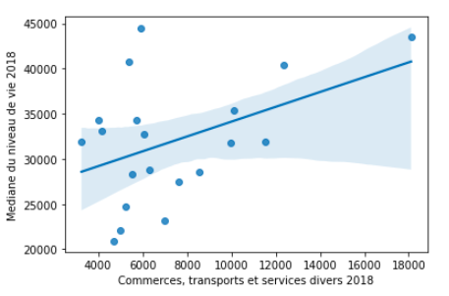

Slide 14
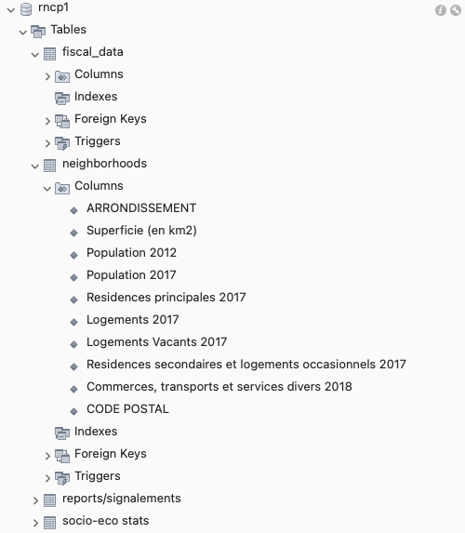
Data base
Relationship database
Easy to conceive and set up
Most common
Easily reused

Slide 15
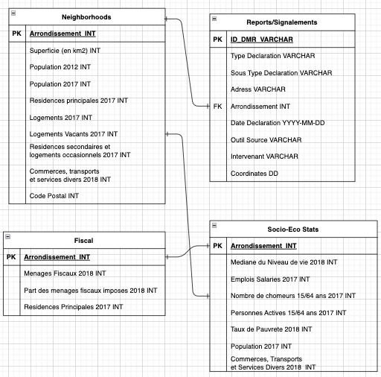
ERD

Slide 16
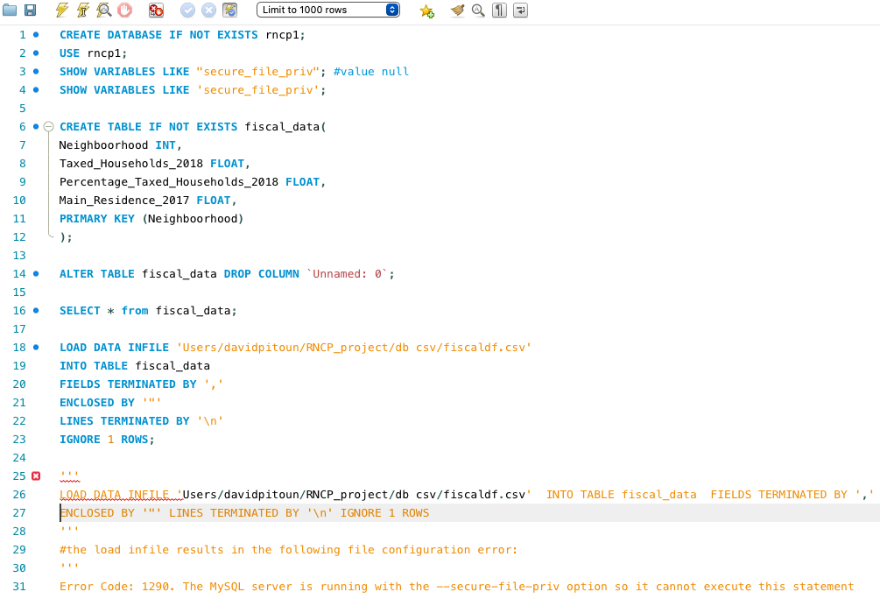

Slide 17
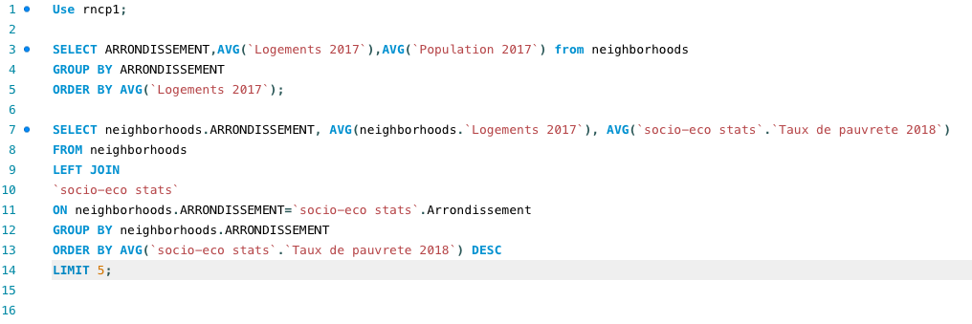

Slide 18
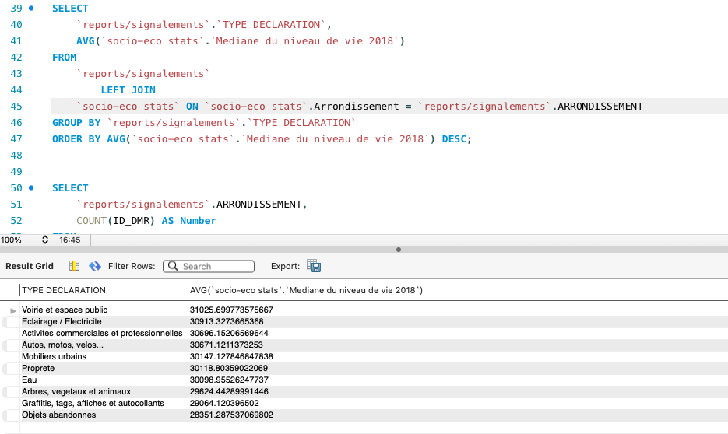
Type de declaration par Niveau de vie

Slide 19
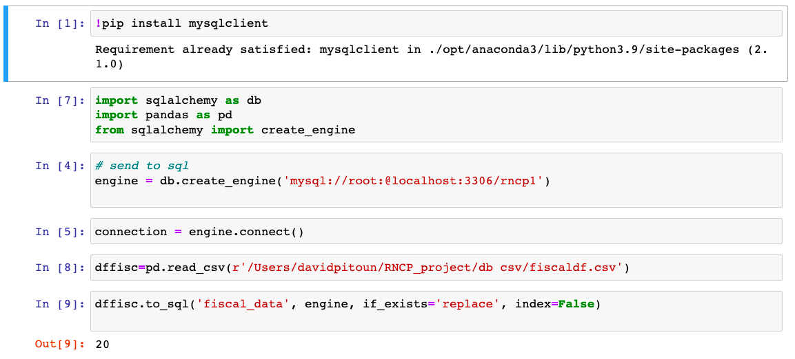
Database Insertion
SqlAlchemy / MySQL

Slide 20

Conclusions
A Socio Economic divide
More technical knowledge and statistical knowledge could bring more insight
Normalized data population
Adding more databases to the study
Velib Roadwork,...

Slide 21
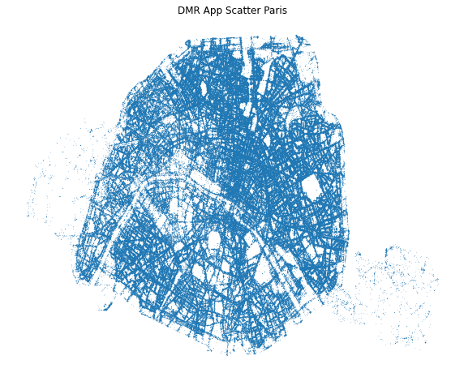
Thank You
Vos
Questions

